Slide 1
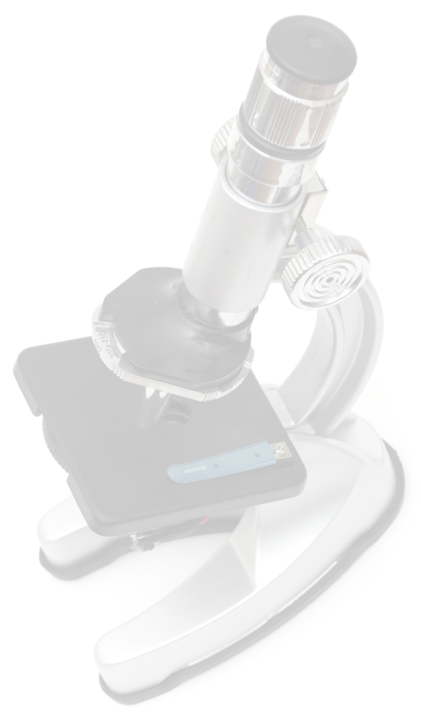
Abstract
Methods & Materials
Results cont.
Conclusion
Your text would go here.
Your text would go here.
Your text would go here.
Your text would go here.
Introduction
TRIFOLD AREA – THIS GUIDE WILL BE REMOVED BEFORE PRINTING – TRIFOLD AREA – THIS GUIDE WILL BE REMOVED BEFORE PRINTING – TRIFOLD AREA – THIS GUIDE WILL BE REMOVED BEFORE PRINTING – TRIFOLD AREA – THIS GUIDE WILL BE REMOVED BEFORE PRINTING – TRIFOLD
TRIFOLD AREA – THIS GUIDE WILL BE REMOVED BEFORE PRINTING – TRIFOLD AREA – THIS GUIDE WILL BE REMOVED BEFORE PRINTING – TRIFOLD AREA – THIS GUIDE WILL BE REMOVED BEFORE PRINTING – TRIFOLD AREA – THIS GUIDE WILL BE REMOVED BEFORE PRINTING – TRIFOLD
Your text would go here.
Limitations
Your text would go here.
Acknowledgements
Results
Your text would go here.
Your text would go here.
Contact Information
Your text would go here.

