Slide 1
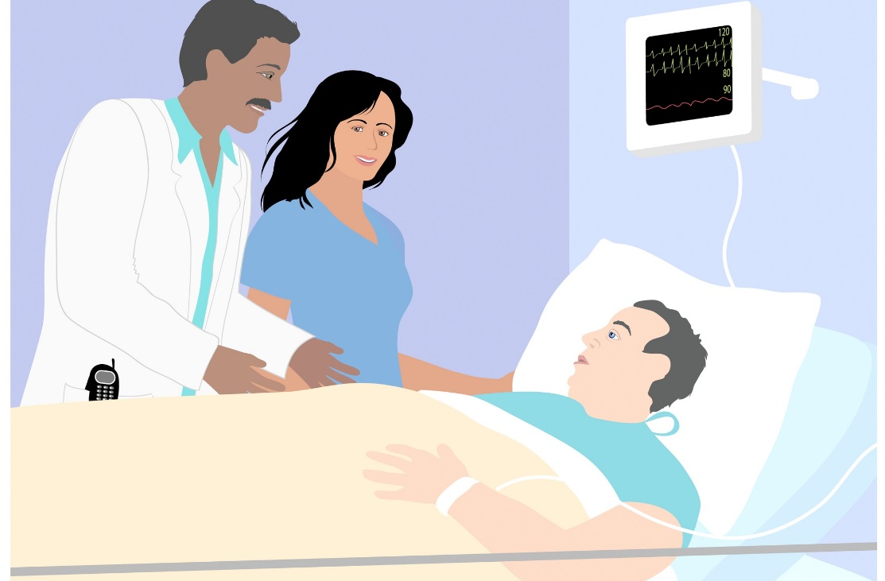
Title
Catches the audience’s eye and draws them in.
Should be short and focused taking up only one line.
Writing
Needs a logical progression leading the reader from Introduction to Conclusion.
Requires careful word choice and placement.
Uses concise phrases and as few words as possible, utilizing bullet points.
Should make it easy to quickly grasp the essence of the work.
Takes time. Create a draft, let it sit, then go back to it.
Is improved by input from others. Try someone unrelated to nursing!
Should be straightforward and acronyms explained.
Images
Every images needs a purpose and be a part of your message.
Provide visual appeal and compliment the text.
Should not be distorted, fuzzy or crammed.
Should not be enlarged or resized from the corners.
Charts & Graphs
Represent the project. If it’s the only thing seen, does it tell the story of the work?
Need descriptive titles and clear X and Y axis labels.
Should include data tables.
Need an indication of the intervention.
Remember…
The intent of the poster is a clear, concise delivery of the telling of the story of your work.
Title
Author(s) and credentials
INTRODUCTION/PROBLEM/
BACKGROUND
Pick one of the suggested headings above and delete the others.
In this section, consider the following:
Describe your overall research problem and include your research question.
Discuss the purpose of your study, how the issue was identified and the reason for doing the project.
Summarize any current research (or current state) related (supported by literature) to your topic as well as any gaps in knowledge.
Tips:
Keep it brief, limit to only important information. Do not need details or results.
Provide statistics that support the need for your project.
METHODS
In this section, consider the following:
This is where you answer the HOW questions.
Describe the design of your study.
Talk about subjects, sampling techniques, inclusion/exclusion criteria, instruments used, data collection, statistical analysis performed, and timelines.
Provide graphical elements (photos, tables or illustrations) of methods (not results) if relevant.
Tips:
Do not put too much here, focus on the results and why your work matters.
RESULTS/OUTCOMES
Provide graphs (with data table), figures, charts or tables to visually communicate your results.
Address any unexpected results.
Tips:
Stick to just the facts. Do not provide opinions. Keep it to an objective description of your results.
(Quantitative)-present your results of data analysis.
(Qualitative)-findings from work.
Include bullet points for ease of reading.
CONCLUSIONS/DISCUSSION
Share your dissemination plans.
Mention any impacts in terms of finances and patient care.
Tips:
Be sure they are supported by your results and are drawn from the outcomes and aims/objectives.
NURSING IMPLICATIONS
In this section, consider the following:
This is where you can show the impact your work will have in the practice setting. What difference have you made?
Talk about the implications your conclusions will have on the topic or problem.
Tips:
Clearly state in short sentences with 1-2 ideas each.
Title
Label
OBJECTIVES/AIMS
Pick one of the suggested headings above and delete the others.
In this section, consider the following:
Indicate what you hope to accomplish, or discover.
List out the goals or objectives of the study.
Include time related information.
Describe any systems or processes you are looking to improve.
Talk about patient populations or other groups that will be impacted.
Identify how you will measure your success
Tips:
Make sure content here matches with your results and outcomes.
Goals need to be specific and measurable.
Provide statistics that support your goals.
Ensure they are clear and readable with use of bullets.
Label
REFERENCES
Make sure they are consistent in format.
If not otherwise directed, model after APA.
Author, A. (Publication Year). Article title. Periodical Title, Volume(Issue), pp.-pp
Caption
CONCLUSIONS/DISCUSSION
Pick one of the suggested headings above and delete the others.
In this section, consider the following:
This is where you will analyze and interpret your results, drawing conclusions from the data presented.
Relate your findings to previous research.
Address any limitations to generalization of your results.
Talk about the changes you will make or any recommendations for actions, lessons learned, further study, direction or next steps.
Discuss implementation and sustainability issues.
RESULTS/OUTCOMES
Pick one of the suggested headings above and delete the others.
In this section, consider the following:
This is where you will present the data and results from your work.
Your content here needs to speak to your Objectives/Aims.
Show pre and post intervention points.
Discuss the effectiveness of your intervention
ACKNOWLEDGEMENTS
Acknowledge anyone who helped with the project or poster that did not meet authorship criteria.
Include sources used on the poster such as images or quotes.

